Slide 1

Team4 Input Output Analysis
Team 3 : 100% Certified

Slide 2
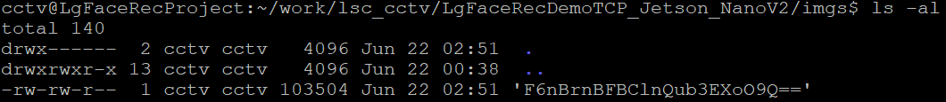

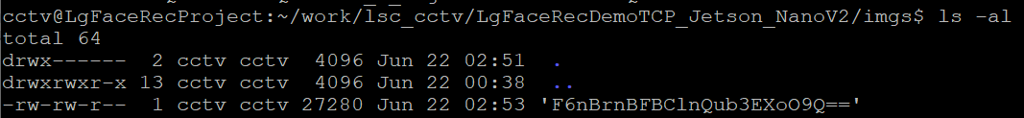
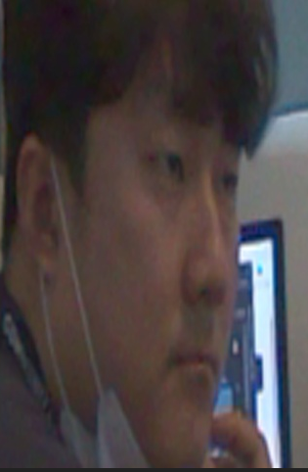
User Register #1
Add a new user named “Mike” using the “Mike.jpg” file
Encrypted image is saved in /imgs directory
The name of “Mike” is encrypted as “F6nBrnBFBClnQub3EXoO9Q==”
< Mike.jpg >
Using the John.jpg photo file to register the same user as Mike
It was saved as "F6nBrnBFBClnQub3EXoO9Q==", which is the same encrypted name as the existing Mike name.
However, in this case, the actual content of the encrypted picture is John's image.
This allows John to access the server room pretending to be Mike.
< John.jpg >

Slide 3
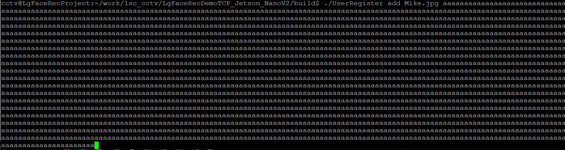
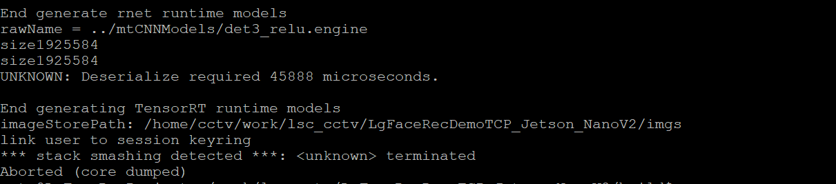
User Register #2
Register a name with a very long string
Stack smashing occurs in the process of encrypting the input name

Slide 4
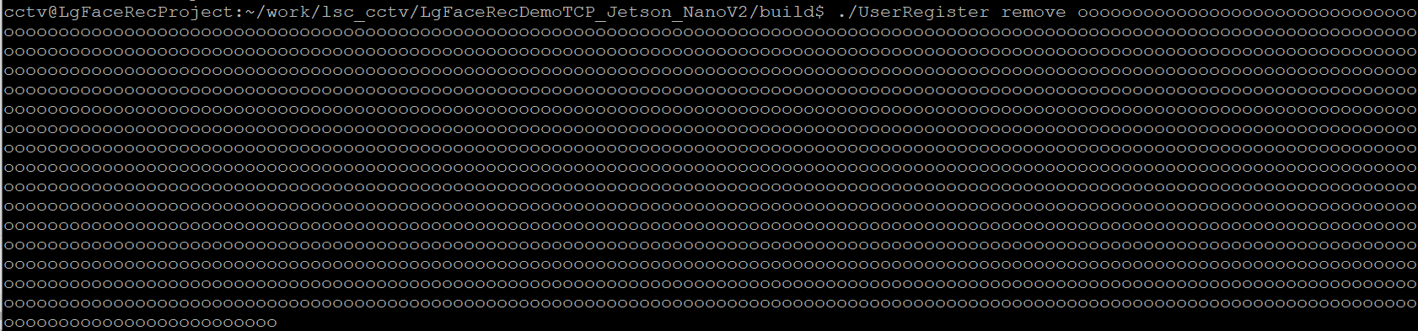
User Register #3
Remove a name with a very long string
Stack smashing occurs in the process of encrypting the input name

Slide 5
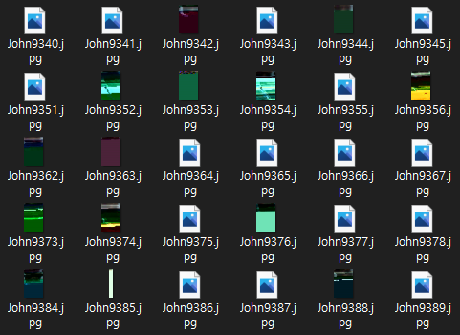
User Register #4
Perform fuzz testing using zuff tool
⬛ Preparation
Generate 10000 manipulated jpeg image files using the zuff tool.
⬛ Fuzz Testing
Attempt to register user using 10000 manipulated images with shell script.
for i in {0..10000}; do zzuf -s$i -r.001 < ../John.jpg > John$i.jpg; done
for f in *.jpg; do echo -n "$f start" >> john.log ; ../UserRegister add $f john ; echo " result : $?" >> john.log; done

Slide 6
User Register #4
Perform fuzz testing using zuff tool
⬛ Test Result
The result tested through the shell script is divided into two types.
1) Return 0 (Normal Termination)
If the JPEG image is damaged, but the header is recognizable and recognized as an image file
The program ended normally through error handling in CCTV.
2) Return 134 (Abnormal Termination)
When the header of the jpeg image is damaged and an exception is handled without being recognized as an image in openCV
The program was terminated due to an exception in OpenCV.
Because CCTV did not handle the exception separately, the program ended with an abort,
It is necessary to handle it so that it ends normally through exception handling for that part.

Slide 7
User Register #4
< Spoofing >
< Stack Smashing (User Add) >
UserRegister
UserRegister
make
Encoded
encrypt_filename
make
Encoded
encrypt_filename
Mike
aaaaaaaaaaaaaaaaaaaaaaaaaaaaaaaaaaaaaaaaaaaaaaaaaaaaaa
No Input
Validation
F6nBrnBFBClnQub3EXoO9Q==
make
Person
ImagePath
main
Image
Changed
make
Person
ImagePath
main
No Input
Validation
OpenSSL
do_crypt
_file
add
Authorized
EVP_CipherUpdate
add
Authorized
Stack
Smashing
F6nBrnBFBClnQub3EXoO9Q==
F6nBrnBFBClnQub3EXoO9Q==

Slide 8
User Register #4
< Stack Smashing (User Remove) >
< Assertion Failed Exception >
UserRegister
UserRegister
loadInput
Image
make
Encoded
No Exception
Handler
encrypt_filename
main
OpenCV
aaaaaaaaaaaaaaaaaaaaaaaaaaaaaaaaaaaaaaaaaaaaaaaaaaaaaa
Assertion Failed
make
Person
ImagePath
main
No Input
Validation
OpenSSL
add
Authorized
EVP_CipherUpdate
resize
remove
Authorized
Stack
Smashing

